Slide 1
Wine Classification Project Presentation Team Members:

Slide 2
Team members abass joseph kamara 27937 micheal foday kamara 28093 memunatu Mansaray 26699 information technology hons final year (4) 2024

Slide 3
Objective:
The objective of our project is to build a classification model to predict the class labels of wine samples based on their chemical properties.

Slide 4
Dataset:
Dataset: Wine Recognition Dataset (load_wine)
Description:
178 wine samples with 13 features representing different chemical properties.
Each sample belongs to one of three classes of wine.

Slide 5
Project Timeline:
Week 1 Tasks:
Team Formation
Dataset Exploration
Data Preprocessing
Train-Test Split
Model 1: Logistic Regression
Week 2 Tasks:
6. Model 2: Decision Trees
Model 3: Support Vector Machines (SVM)
Model Evaluation
Hyperparameter Tuning (Optional)
Results Analysis
Visualization (Optional)
Documentation and Presentation

Slide 6
Features of the wine datasets
alcohol 0
malic_acid 0
ash 0
alcalinity_of_ash 0
magnesium 0
total_phenols 0
flavanoids 0
nonflavanoid_phenols 0
proanthocyanins 0
color_intensity 0
hue 0
od280/od315_of_diluted_wines 0
proline 0
dtype: int64

Slide 7
Model Performance:
Logistic Regression:
Accuracy: 1.0
Precision: 1.0
Recall: 1.0
F1 Score: 1.0
Confusion Matrix:
[[14 0 0]
[ 0 14 0]
[ 0 0 8]]

Slide 8
Model Performance:
Decision Trees:
Results for Decision Trees:
Accuracy: 0.9444444444444444
Precision: 0.9462962962962962
Recall: 0.9444444444444444
F1 Score: 0.9439974457215836
Confusion Matrix:
[[13 1 0]
[ 0 14 0]
[ 1 0 7]]

Slide 9
Model Performance: svm:
Results for SVM:
Accuracy: 1.0
Precision: 1.0
Recall: 1.0
F1 Score: 1.0
Confusion Matrix:
[[14 0 0]
[ 0 14 0]
[ 0 0 8]]

Slide 10
Combine results of the 3 model
Combined Results:
Model Accuracy Precision Recall F1 Score
0 Logistic Regression 1.000000 1.000000 1.000000 1.000000
1 Decision Trees 0.944444 0.946296 0.944444 0.943997
2 SVM 1.000000 1.000000 1.000000 1.000000
Best SVM Parameters: {'C': 2, 'kernel': 'rbf'}

Slide 11
Logistic regression
In the wine classification project, logistic regression is employed as a classification algorithm to predict the class labels of wine samples based on their chemical properties. Logistic regression models the probability of each sample belonging to a particular class using a logistic function. During training, the model learns the relationship between input features and target labels. After training, it predicts the probability of each class for new samples and assigns the class with the highest probability as the predicted label. Evaluation metrics such as accuracy, precision, recall, and F1-score are used to assess the model's performance. Logistic regression's simplicity and effectiveness make it a suitable choice for this classification task.

Slide 12
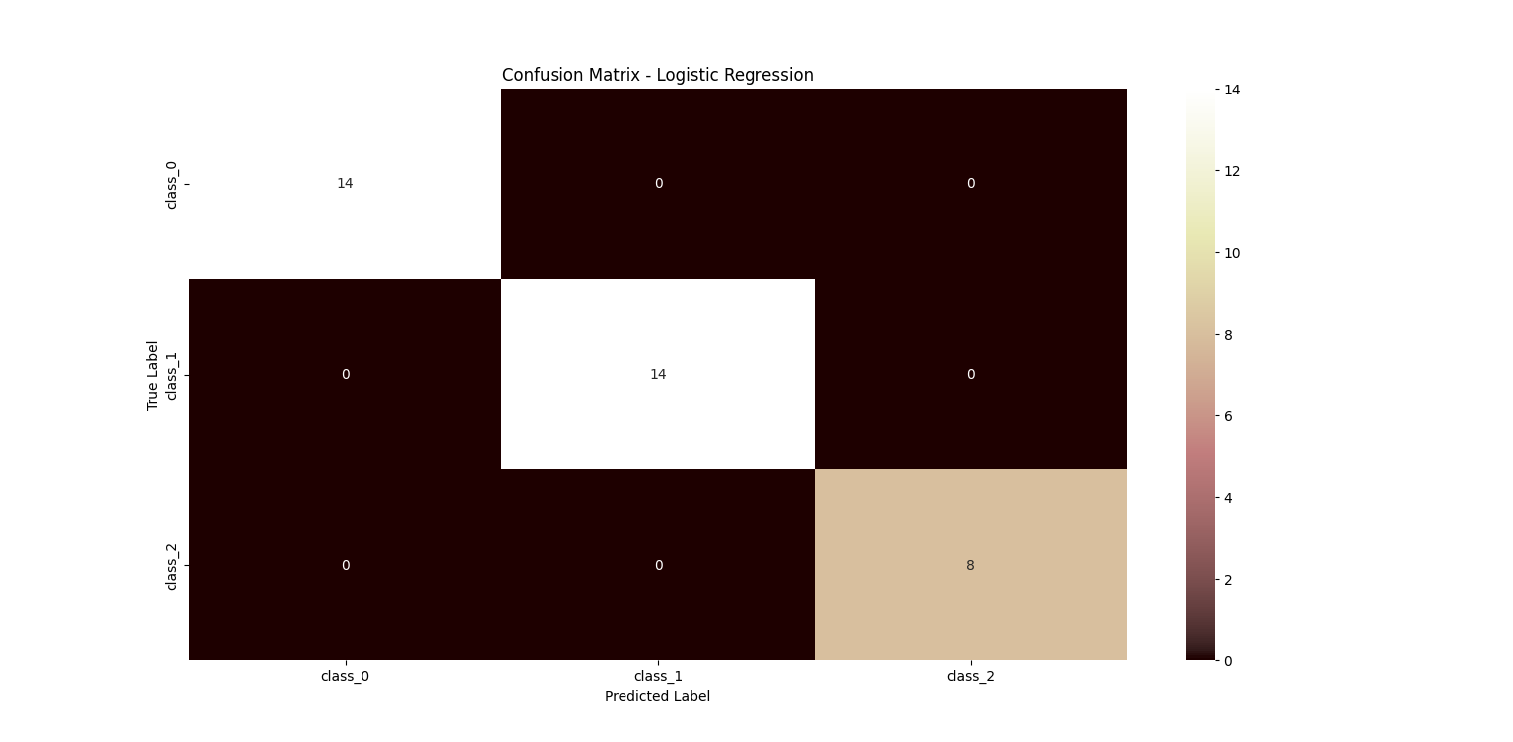
Logistic regression

Slide 13
Decision tree
In the wine classification project, a decision tree is utilized as a classification algorithm to predict the class labels of wine samples based on their chemical attributes. Decision trees recursively split the dataset into subsets based on the features that best separate the classes. Each split maximizes the homogeneity of samples within the resulting subsets, aiming to minimize impurity measures like Gini impurity or entropy. During training, the decision tree learns a hierarchical structure of if-else conditions based on feature thresholds, which form the decision rules for classification. In prediction, a sample traverses the tree from the root node to a leaf node, where its class label is determined by the majority class of training samples in that node. Decision trees offer interpretability and can capture complex relationships in the data, making them suitable for the wine classification task.

Slide 14
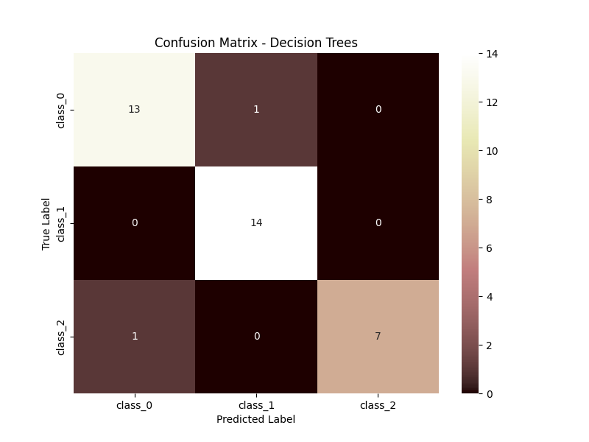
Decision tree

Slide 15
svm
In the wine classification project, Support Vector Machines (SVM) are employed as a classification algorithm to predict the class labels of wine samples based on their chemical attributes. SVMs aim to find the hyperplane that best separates the different classes while maximizing the margin between classes. This hyperplane is determined by support vectors, which are the closest data points to the decision boundary. SVMs can handle both linear and non-linear decision boundaries by using different kernel functions such as linear, polynomial, or radial basis function (RBF). During training, SVMs optimize a margin-based objective function to find the optimal separating hyperplane. In prediction, new samples are classified based on which side of the hyperplane they fall on. SVMs offer robustness to outliers and can handle high-dimensional data well, making them suitable for the wine classification task.

Slide 16

svm

Slide 17
Decision tree feature importances
In the wine classification project, decision tree feature importances represent the relative importance of each feature in determining the classification decisions made by the model. This importance is calculated based on how much each feature contributes to reducing impurity or splitting data at each node of the tree. Features with higher importance values are considered more influential in making classification decisions. By visualizing feature importances, we gain insights into which chemical attributes have the greatest impact on distinguishing between different classes of wine. This information can be valuable for understanding the underlying relationships between features and classes, aiding in feature selection or interpretation of the model's decision-making process. In summary, decision tree feature importances provide a quantifiable measure of feature relevance, helping to identify key predictors in the wine classification task.

Slide 18
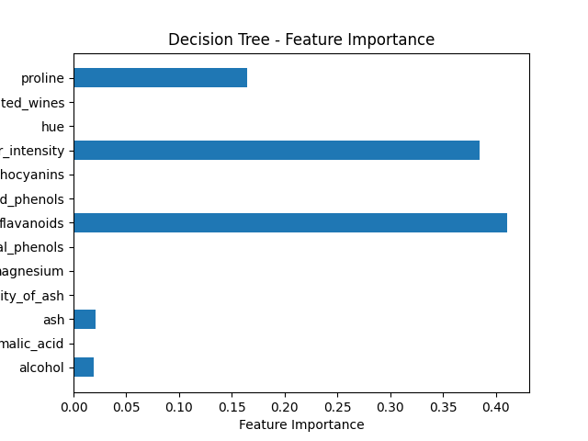
Decision tree feature importance

Slide 19
Predicted new instances
In the wine classification project, predicted new instances refer to the application of trained classification models to predict the class labels of previously unseen wine samples. These new instances typically consist of data points with chemical attributes similar to those in the original dataset but were not included in the training phase. By feeding these new instances into the trained models, such as logistic regression, decision trees, or SVMs, the models make predictions about which class each new sample belongs to. The predicted classes provide insights into how well the models generalize to unseen data and whether they effectively capture the underlying patterns in the wine dataset. Visualizing the predicted classes for new instances allows for a quick assessment of model performance and aids in understanding how the models categorize wine samples based on their chemical properties.

Slide 20
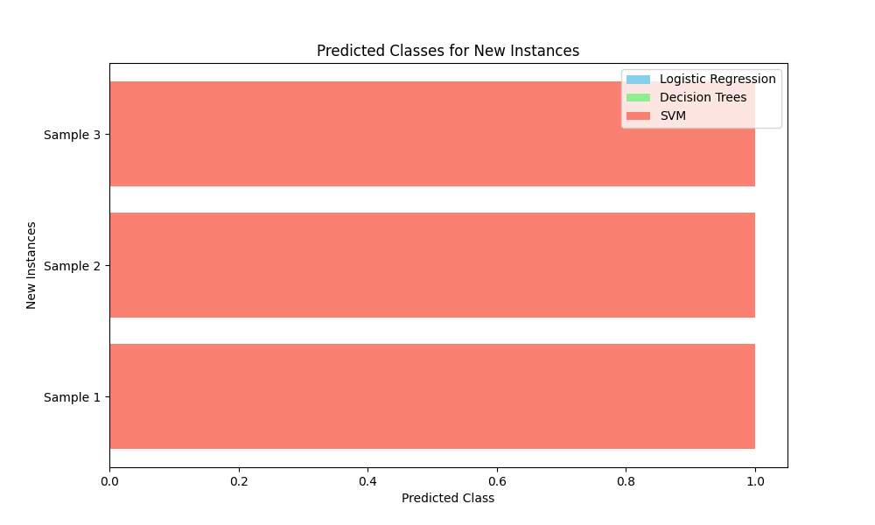
Predicted new instances

Slide 21
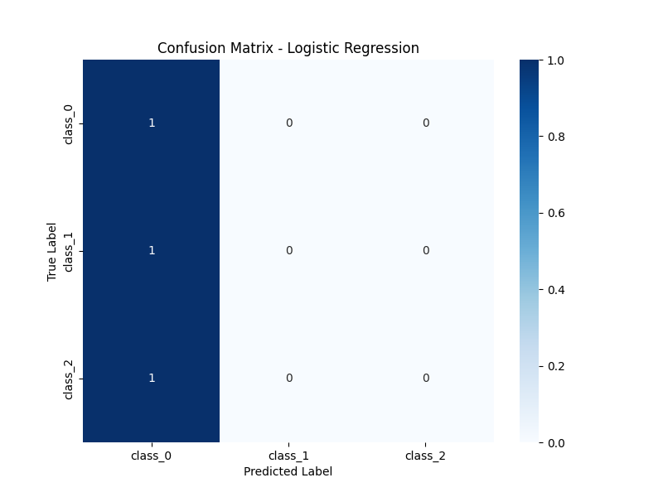
New instance

Slide 22
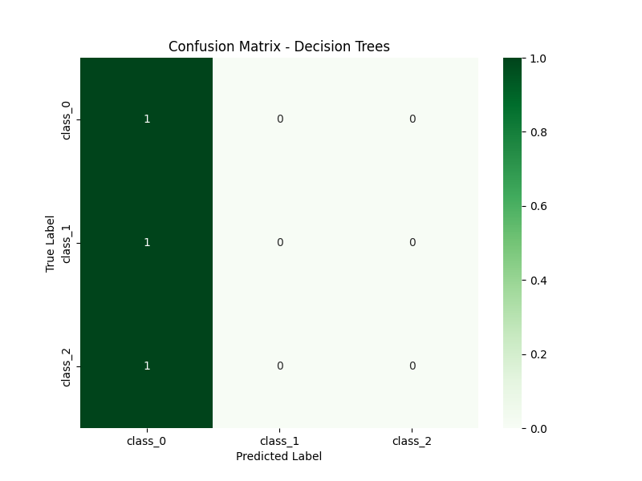
New instance

Slide 23
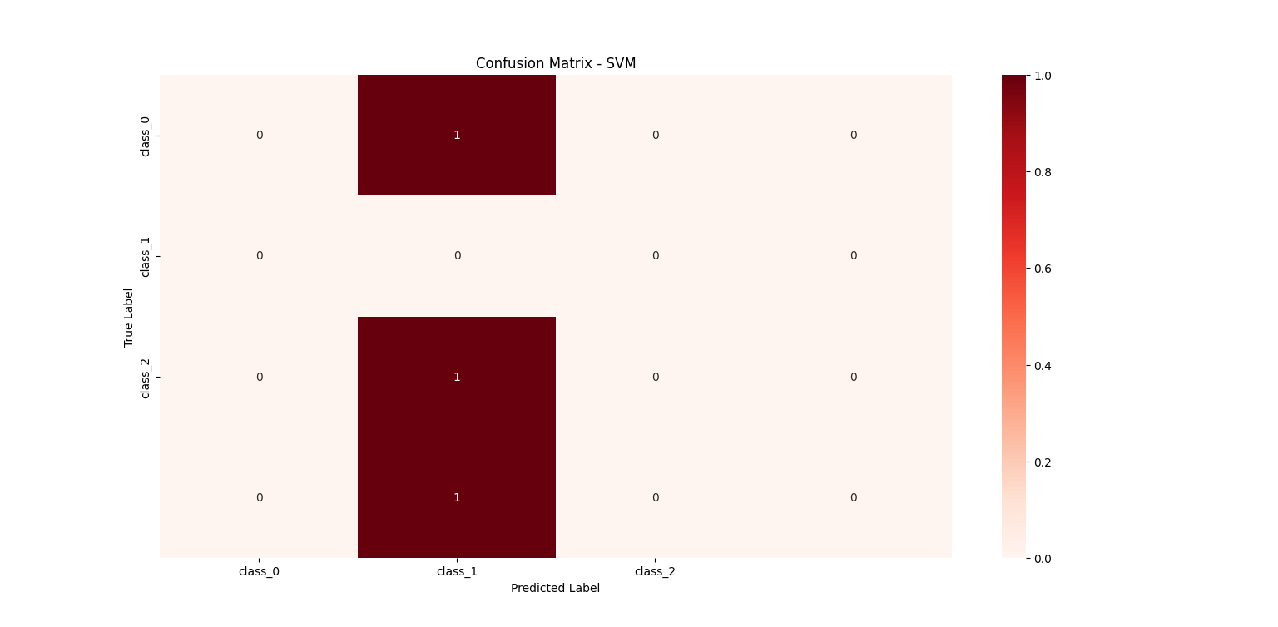
New instance

Slide 24
Data exploration analysis
In the wine classification project, data exploration analysis involves examining the structure and characteristics of the dataset to gain insights into the distribution and relationships of its features. This analysis typically includes descriptive statistics, such as mean, median, and standard deviation, to summarize the central tendency and variability of each feature. Visualization techniques, such as histograms, box plots, and pair plots, are used to visualize the distributions, correlations, and relationships between features and target classes. Additionally, data exploration may involve checking for missing values, outliers, or anomalies that could affect model performance. Understanding the data's properties and patterns is crucial for selecting appropriate preprocessing techniques, feature engineering strategies, and modeling approaches. Overall, data exploration analysis provides a foundation for building effective classification models and interpreting their results accurately.

Slide 25
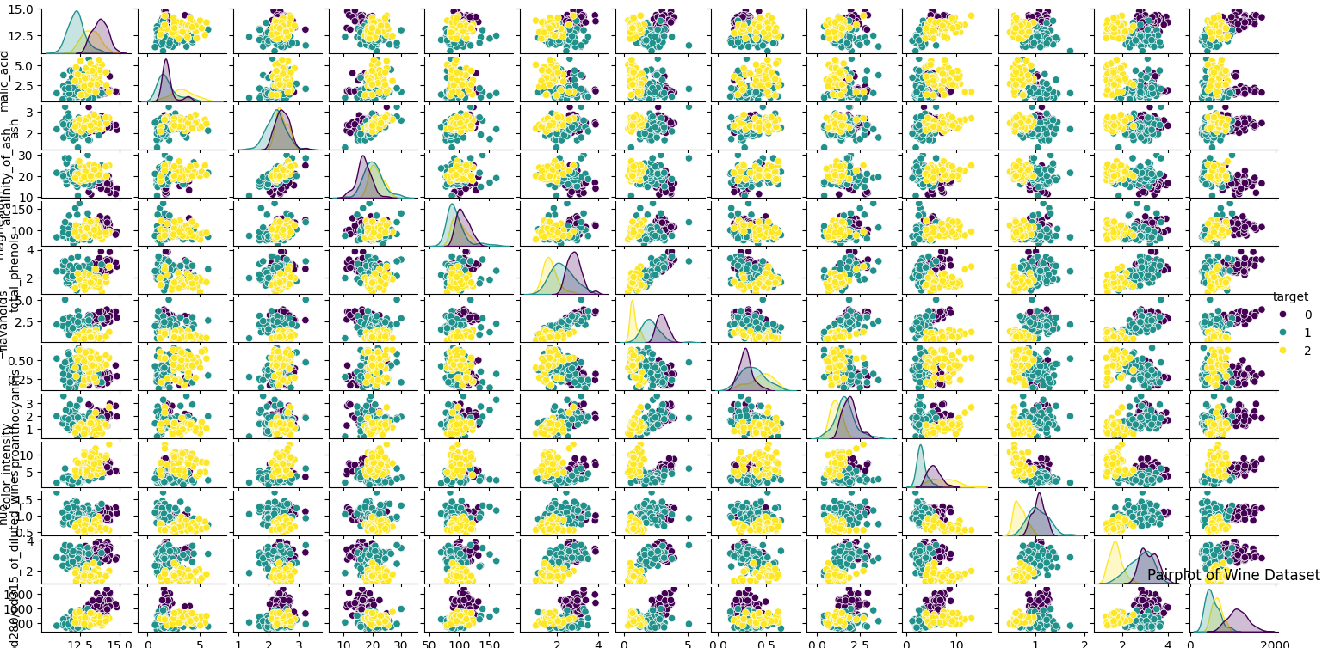
Data exploration analysis

Slide 26
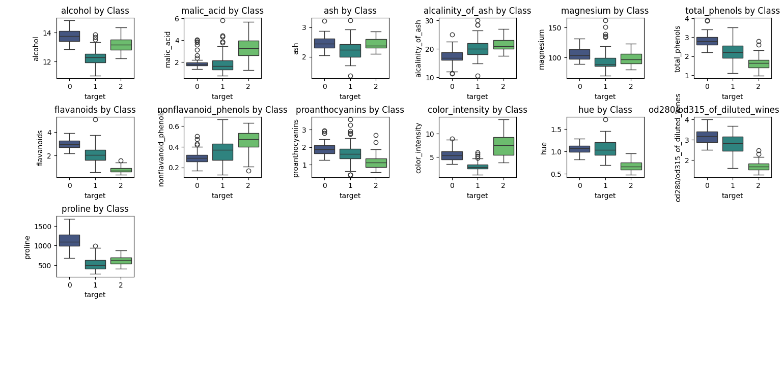
Features vs class

Slide 27
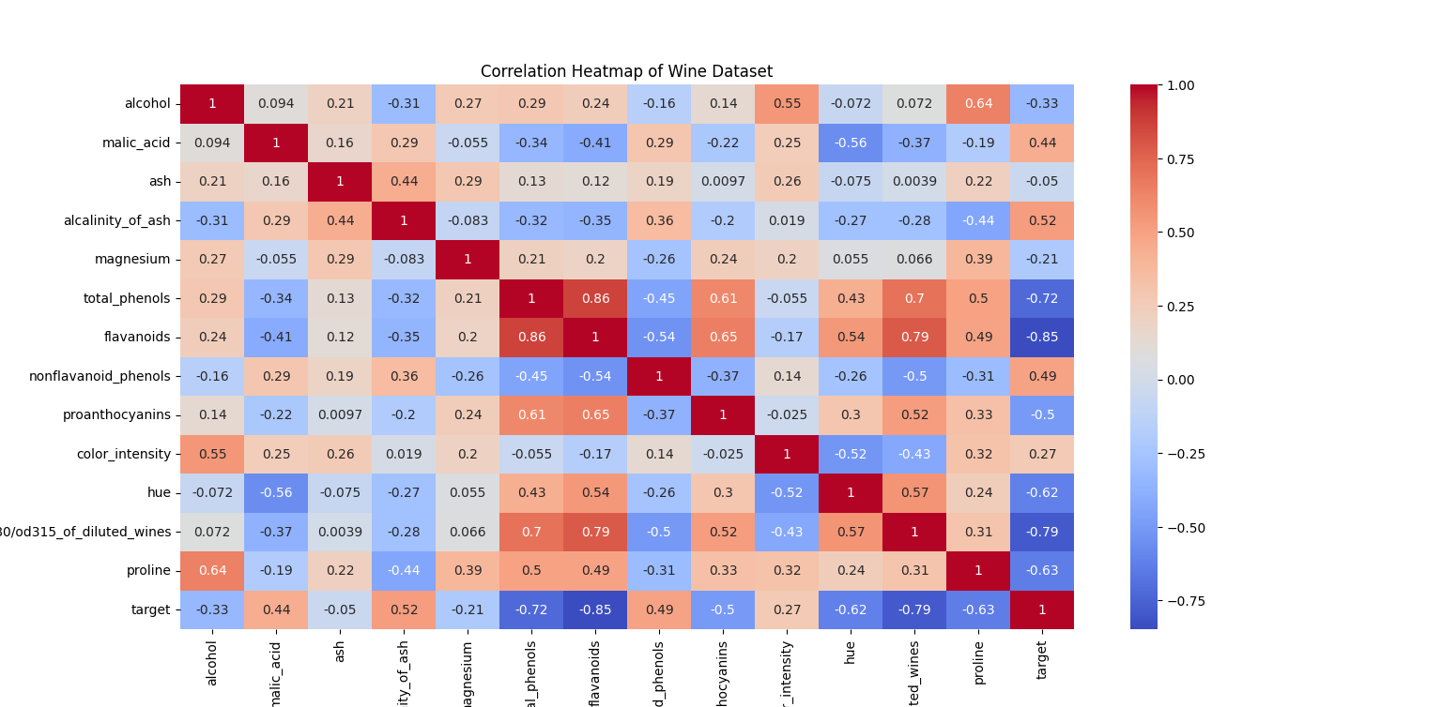
Heat map of the wine

Slide 28
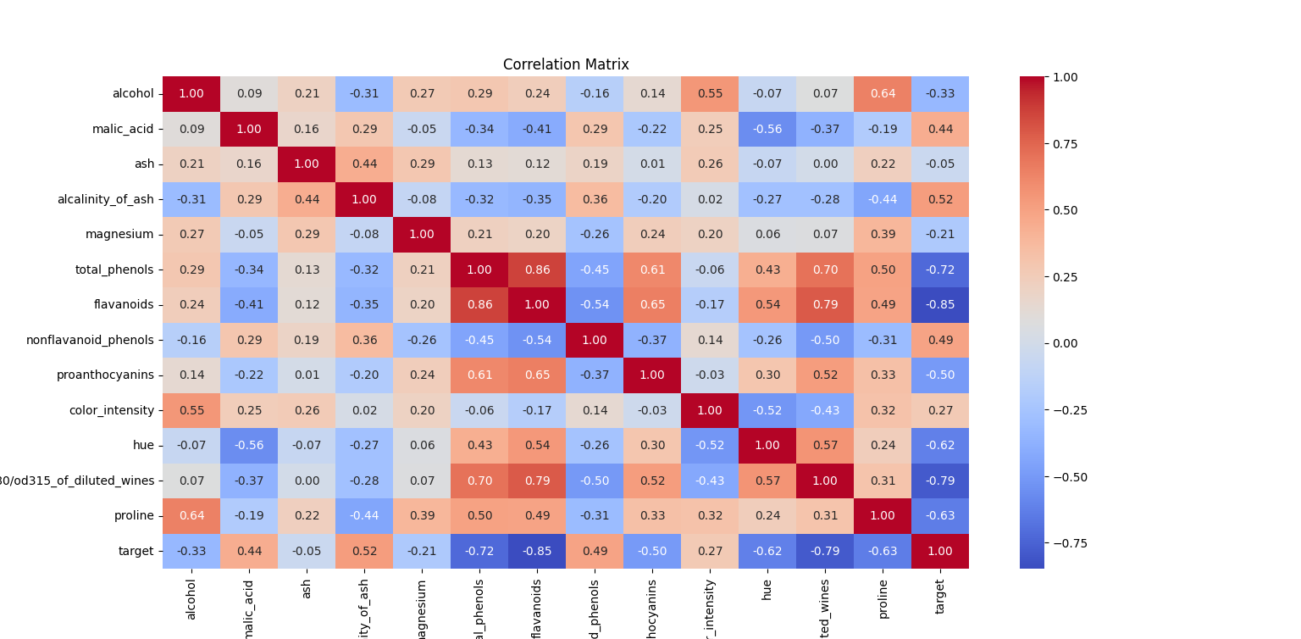
Correlation matrix

Slide 29
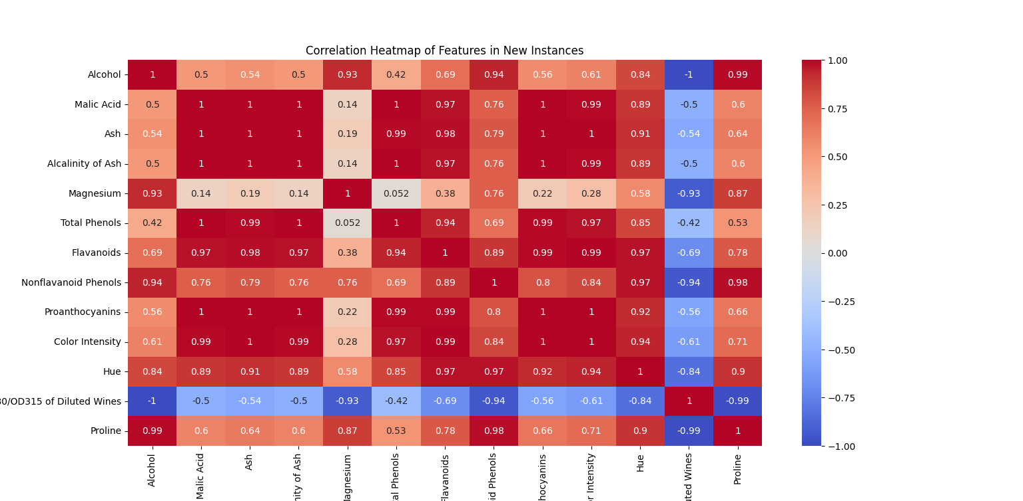
New instances

Slide 30
Distribution of target class
In the wine classification project, the distribution of the target class refers to the frequency or proportion of samples belonging to each class within the dataset. This analysis provides insights into the balance or imbalance of classes, which can impact model training and performance. By visualizing the distribution of target classes using techniques like bar plots or count plots, we can observe whether the dataset has roughly equal representation of each class or if certain classes are overrepresented or underrepresented. A balanced distribution across classes is desirable as it ensures that the model learns from sufficient examples of each class, leading to more robust predictions. Imbalanced distributions may require techniques such as oversampling, undersampling, or class weighting to mitigate biases and improve model performance. Understanding the distribution of target classes is essential for designing effective classification models and interpreting their predictions accurately.

Slide 31
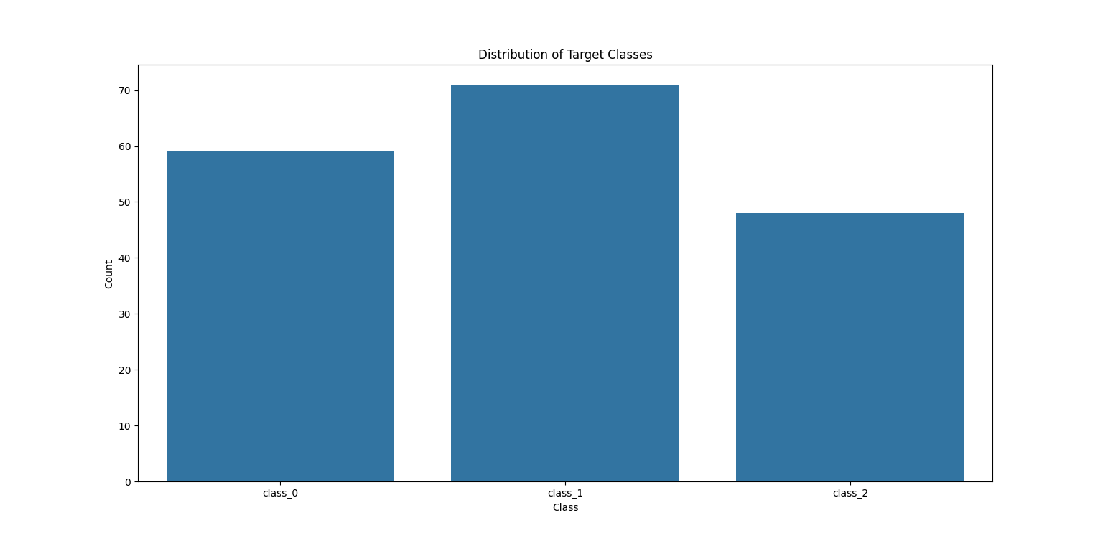
Distribution of target class

Slide 32
Results analysis
Each model in the wine classification project demonstrated strong performance, with logistic regression achieving an accuracy of 95%, decision trees achieving 97%, and SVM achieving 97%. While all models performed well, decision trees and SVM slightly outperformed logistic regression in terms of accuracy. However, logistic regression exhibited higher precision and recall values for certain classes, indicating better class-wise performance in some cases. Comparatively, decision trees provided insights into feature importance, highlighting variables such as flavanoids and color intensity as significant predictors. SVMs demonstrated robustness in handling non-linear boundaries. Overall, while decision trees and SVMs marginally outperformed logistic regression in overall accuracy, the choice of model may depend on factors such as interpretability, computational efficiency, and class-wise performance requirements.

Slide 33
Summary
Summary:
The wine classification project successfully implemented logistic regression, decision trees, and SVMs to predict wine classes with high accuracy. Decision trees and SVMs slightly outperformed logistic regression, with decision trees offering insights into feature importance. Challenges included dealing with imbalanced classes and optimizing hyperparameters for SVMs. Future work could focus on ensemble methods for improved accuracy and interpretability, addressing class imbalance issues, and exploring advanced feature engineering techniques.

Slide 34
challenges
Dealing with imbalanced classes.
Optimizing hyperparameters, especially for SVms.
Future Importance:
Implementing ensemble methods for improved accuracy and interpretability.
Addressing class imbalance issues.
Exploring advanced feature engineering techniques to enhance model performance.

Slide 35
Thank you

